Slide 1
7. Smart Contracts
Mastering Ethereum - Building Smart Contracts and DApps, 2018

Slide 2
Introduction
Two different types of accounts in Ethereum: externally owned accounts (EOAs) and contract accounts.
EOAs are controlled by users, often via software such as a wallet application that is external to the Ethereum platform.
Contract accounts are controlled by program code (also commonly referred to as “smart contracts”) that is executed by the Ethereum Virtual Machine.
EOAs are simple accounts without any associated code or data storage, whereas contract accounts have both associated code and data storage.
EOAs are controlled by transactions created and cryptographically signed with a private key in the “real world” external to and independent of the protocol, whereas contract accounts do not have private keys and so “control themselves” in the predetermined way prescribed by their smart contract code.

Slide 3
Smart Contracts
Immutable computer programs that run deterministically in the context of an Ethereum Virtual Machine as part of the Ethereum network protocol — i.e., on the decentralized Ethereum world computer.
Smart contracts are simply computer programs.
Once deployed, the code of a smart contract cannot change. Unlike with traditional software, the only way to modify a smart contract is to deploy a new instance.
The outcome of the execution of a smart contract is the same for everyone who runs it, given the context of the transaction that initiated its execution and the state of the Ethereum blockchain at the moment of execution.

Slide 4
Life Cycle of a Smart Contract (1/2)
Smart contracts are typically written in a high-level language, such as Solidity. But in order to run, they must be compiled to the low-level bytecode that runs in the EVM.
Once compiled, they are deployed on the Ethereum platform using a special contract creation transaction, which is identified as such by being sent to the special contract creation address, namely 0x0.
Each contract is identified by an Ethereum address, which is derived from the creation transaction as a function of the originating account and nonce.
A contract can call another contract that can call another contract, and so on, but the first contract in such a chain of execution will always have been called by a transaction from an EOA.

Slide 5
Life Cycle of a Smart Contract (2/2)
Smart contracts are not executed “in parallel” in any sense — the Ethereum world computer can be considered to be a single-threaded machine.
Transactions are atomic, regardless of how many contracts they call or what those contracts do when called.
Transactions execute in their entirety, with any changes in the global state (contracts, accounts, etc.) recorded only if all execution terminates successfully.
A contract can be “deleted,” removing the code and its internal state (storage) from its address, leaving a blank account.
To delete a contract, you execute an EVM opcode called SELFDESTRUCT.

Slide 6
The Ethereum Contract ABI (1/3)
An application binary interface is an interface between two program modules; often, between the operating system and user programs.
ABI defines how data structures and functions are accessed in machine code.
In Ethereum, the ABI is used to encode contract calls for the EVM and to read data out of transactions. The purpose of an ABI is to define the functions in the contract that can be invoked and describe how each function will accept arguments and return its result.
A contract’s ABI is specified as a JSON array of function descriptions and events. This JSON can be used by any application that wants to access the contract once it is deployed.
All that is needed for any application to interact with a contract is an ABI and the address where the contract has been deployed.

Slide 7
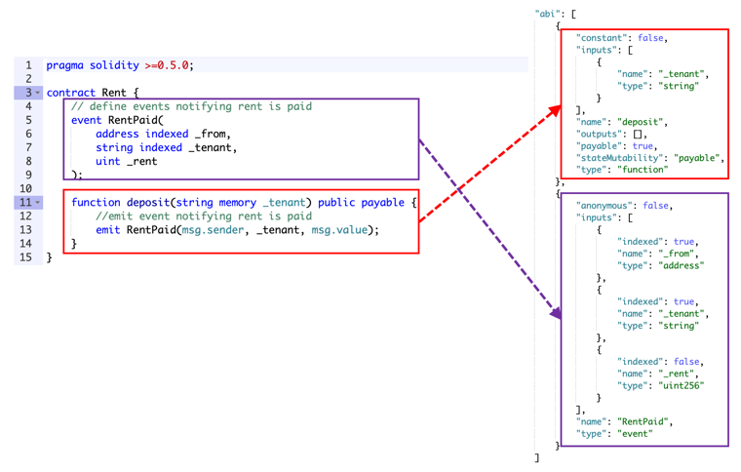
The Ethereum Contract ABI (2/3)
Contract Application Binary Interface (ABI) is the interface that specifies how to interact with a specific Ethereum contract. This includes the method names, parameters, constants, data structures, event types (logs), and everything else you need to know about the contract.
https://docs.alchemy.com/docs/deep-dive-into-eth_getlogs#what-are-abis

Slide 8
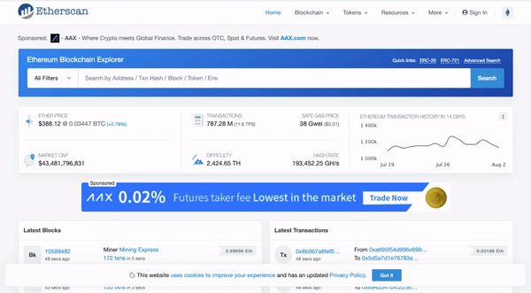
The Ethereum Contract ABI (3/3)
You can find the ABI for a specific contract by going to Etherscan and pasting in the address field of the contract in the search bar, then clicking on the "contract" tab and scrolling down to "Contract ABI".

Slide 9
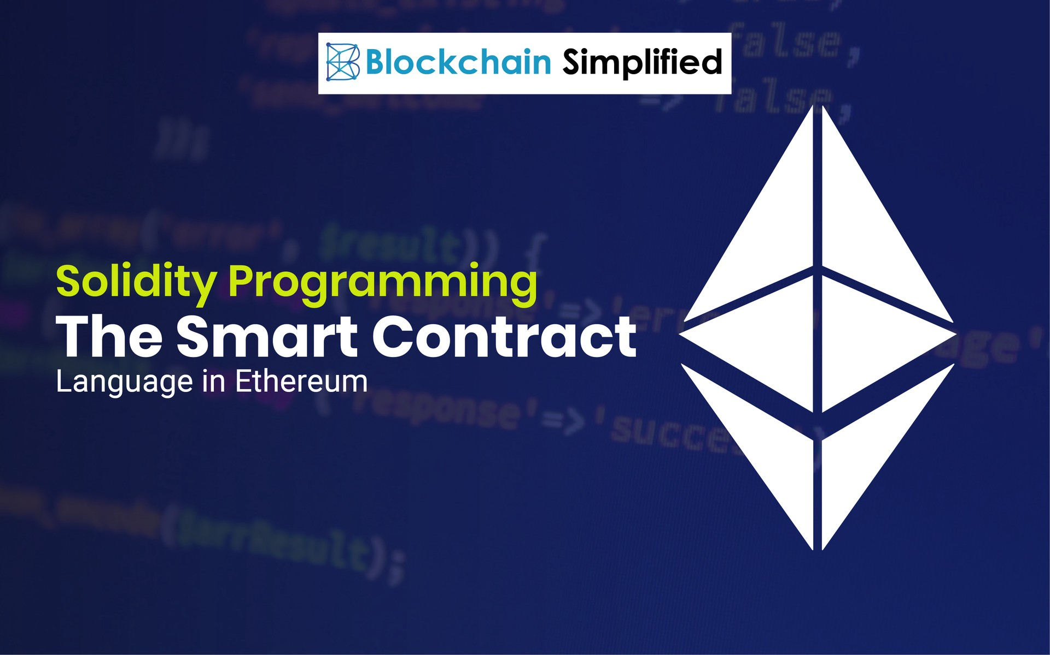
Programming with Solidity (P.272 ~ P.303)
Data Types, Predefined Global Variables and Functions
Contract Definition
Functions
Contract Constructor and selfdestruct
Function Modifiers
Contract Inheritance
Error Handling
Events
Calling Other Contracts

Slide 10
Ref. Selfdestruct a Smart Contract
After a contract call selfdestruct, the code and storage associated with the contract are removed from the Ethereum’s World State.
Transactions after that point will behave as if the address were an EOA, i.e. transaction will be accepted, no processing will be done, and the transaction status will be success.
Transactions will do nothing, but you still have to pay the transaction fee. You can even transfer ether. It will be locked forever.

Slide 11


Ref. Solidity Tutorials
Solidity Tutorial - Basics: Functions
Smart Contracts 101 - Create a Simple Ethereum Smart Contract with Solidity
Smart Contracts 101 - Simple Ether Wallet Smart Contract Tutorial
Smart Contract Tutorial - Vending Machine Smart Contract in Solidity
Deploy a smart contract to Ethereum using Truffle - A step-by-step guide
Solidity Tutorial

Slide 12
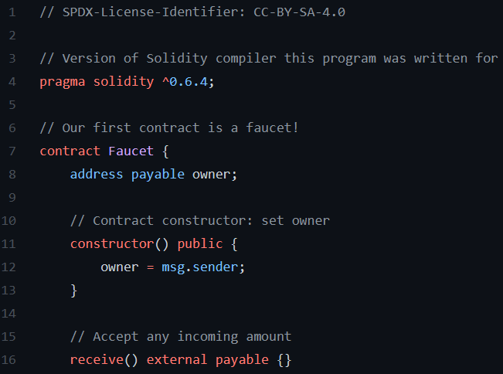
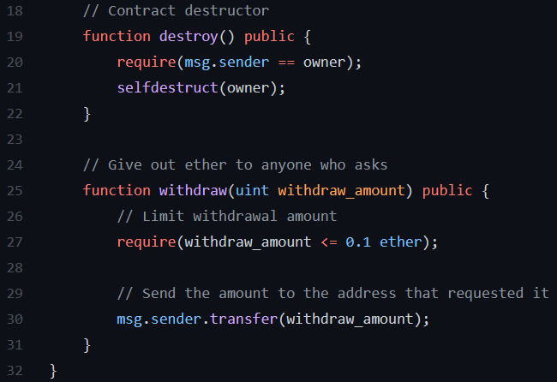
Hw2: Programming a Better Faucet Contract
Homework-2: Learn to install/configure Truffle to connect to Ropsten
Sepolia

Slide 13
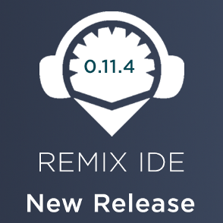
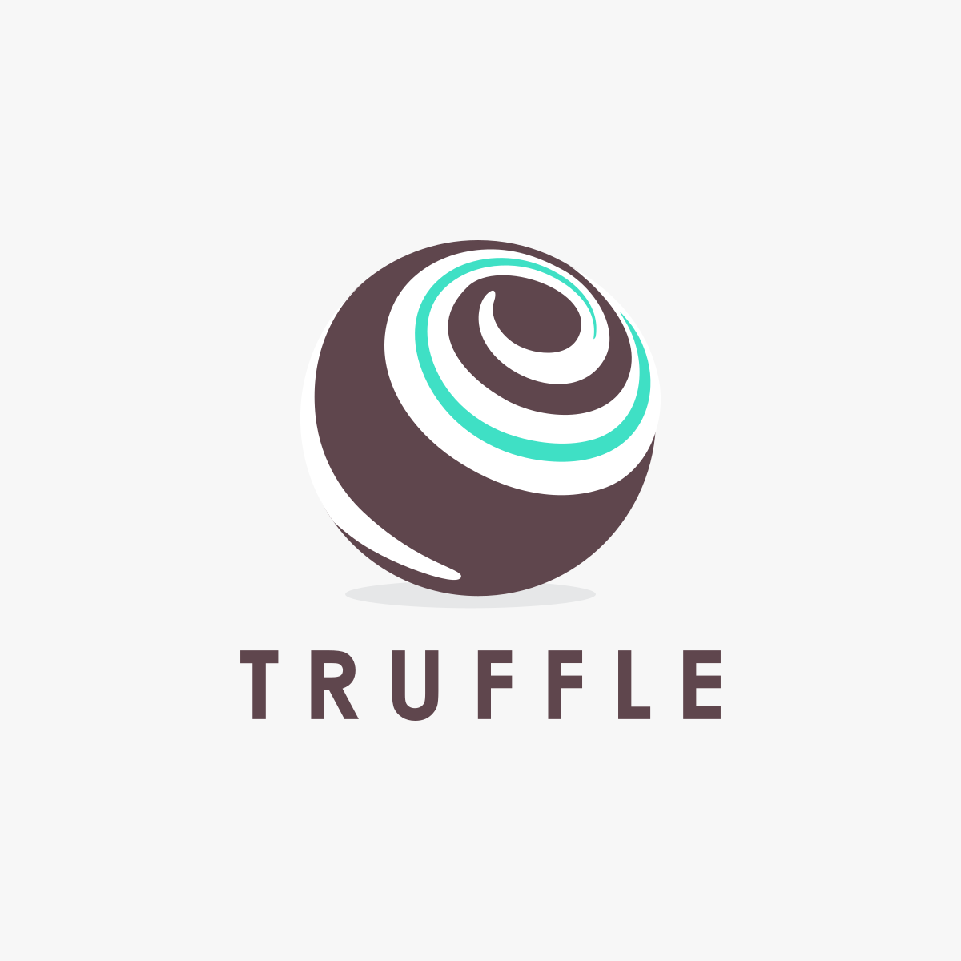
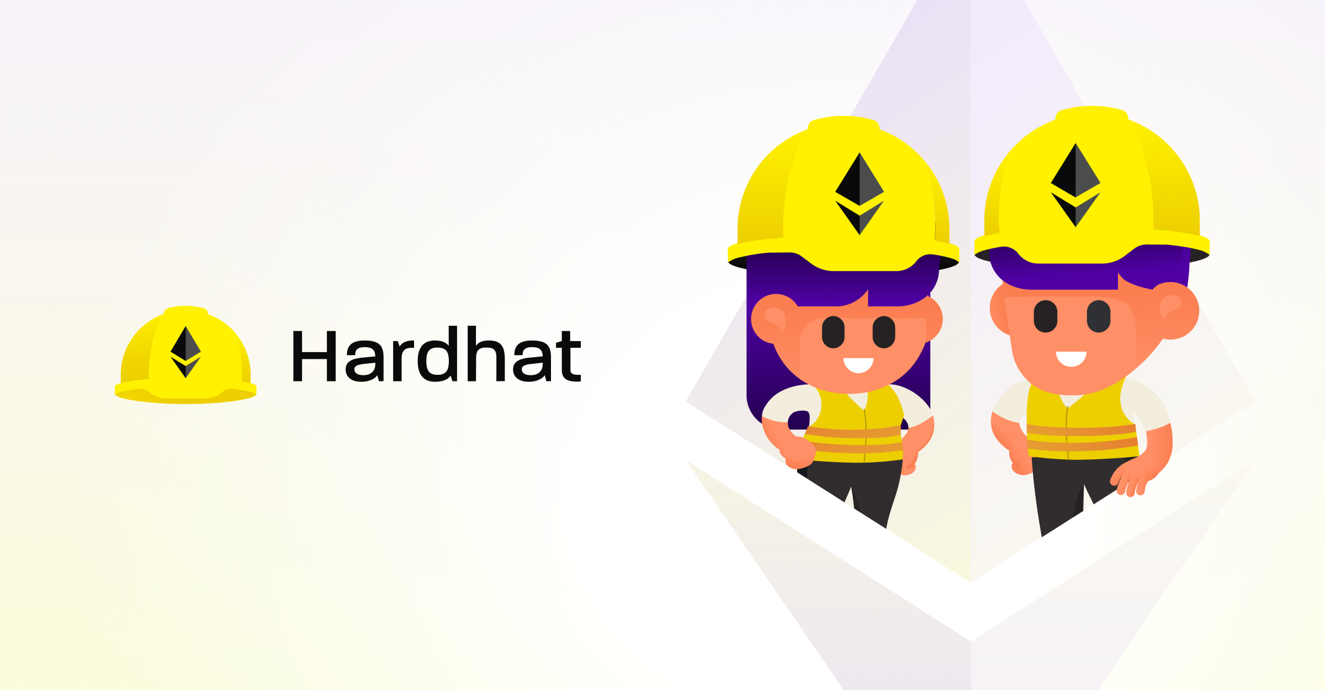
Development Tools for Smart Contracts (1/2)
Remix vs. Truffle (Node.js & Web3.js needed)
Remix is an online/browser IDE with editor for Solidity programming. Easy to use/experiment and good for beginners. But not very extensible.
Truffle is a JavaScript development environment/framework for Solidity smart contracts. It runs on Node.js. Use Command-line Interface. Can be used to build front-end of DApp, which is directly integrated with smart contracts.
E.g. use remix for testing out solidity codes after writing them. Make sure all the functions are working as expected. Then move the sol file to VScode and use Truffle to continue with the deployment of the code to the main net or the test nets.

Slide 14
Development Tools for Smart Contracts (2/2)
Web3.js or Web3.py? What is the more mature API to interact with Ethereum?
https://ethereum.stackexchange.com/questions/45867/web3-js-or-web3-py-what-is-the-more-mature-api-to-interact-with-ethereum
JavaScript is the dominant client-side scripting language of the Web.
Web3.py seems to have a great future in the Ethereum ecosystem and Python is more readable than JavaScript.
Brownie is a Python-based development and testing framework for smart contracts targeting the Ethereum Virtual Machine.
Remix & Web3.py Tutorial: https://www.youtube.com/watch?v=M576WGiDBdQ

Slide 15
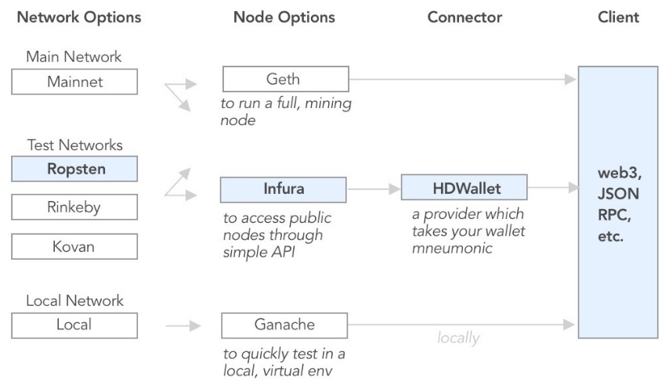
Smart Contract Deployment Options (1/2)

Slide 16
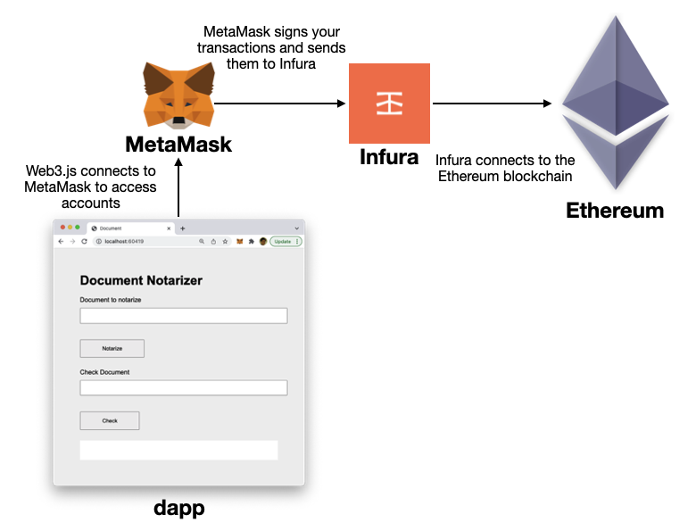
Smart Contract Deployment Options (2/2)
Infura is a collection of full nodes on the Ethereum network that enable developers to connect to these nodes through its interface. It is a method for connecting to the Ethereum network without having to run a full node, and the service is provided by the company Consensys.

Slide 17

Smart Contract Security
Security Best Practices
Minimalism/simplicity, Code reuse, Code quality
Readability/auditability, Test coverage
Security Risks and Antipatterns
Reentrancy, Arithmetic Over/Underflows, Unexpected Ether
DELEGATECALL, Default Visibilities, Entropy Illusion
External Contract Referencing, Short Address/Parameter Attack
Unchecked CALL Return Values, Race Conditions/Front Running
Denial of Service (DoS), Block Timestamp Manipulation
Constructors with Care, Uninitialized Storage Pointers
Floating Point and Precision, Tx.Origin Authentication, Contract Libraries

Slide 18
Security Risk: Reentrancy
One of the features of Ethereum smart contracts is their ability to call and utilize code from other external contracts.
These external calls can be hijacked by attackers, who can force the contracts to execute further code (through a fallback function), including calls back into themselves. Attacks of this kind were used in the infamous DAO hack.
The term “reentrancy” comes from the fact that the external malicious contract calls a function on the vulnerable contract and the path of code execution “reenters” it. Example code of Reentrancy Attack: P.333 ~ P.336
Preventative Techniques
Use the built-in transfer function when sending ether to external contracts.
Ensure that all logic that changes state variables happens before ether is sent out of the contract.
Add a state variable that locks the contract during code execution, preventing reentrant calls.

Slide 19
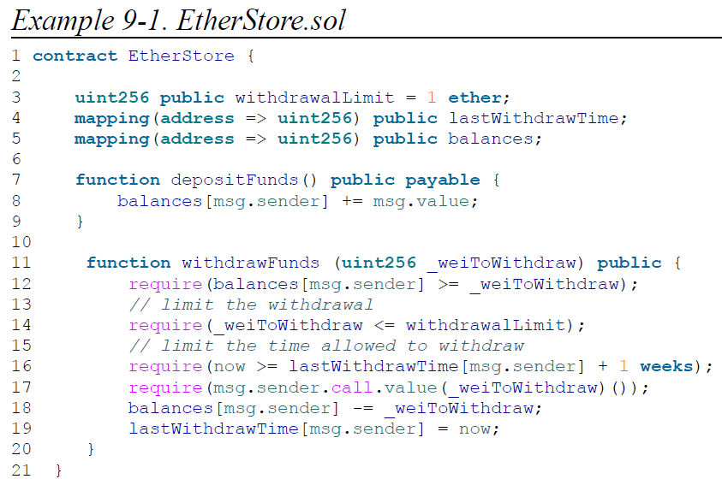

E.g. Vulnerable Contract of Reentrancy (1/4)
Ethereum vault that allows depositors to withdraw only 1 ether per week
This function is intended to succeed only if the requested amount to withdraw is less than 1 ether and a withdrawal has not occurred in the last week.
Transfer eth to msg.sender
Update balance of msg.sender

Slide 20
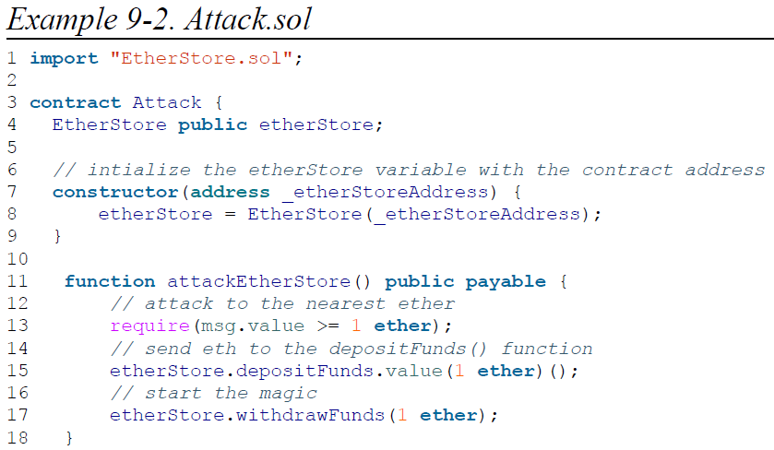
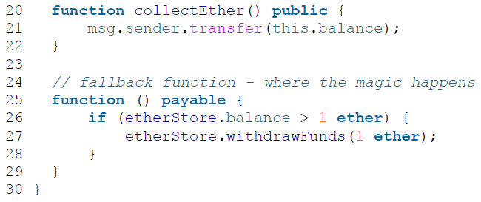
E.g. Vulnerable Contract of Reentrancy (2/4)
Reentrancy code!!!
First, the attacker would create the malicious contract (let’s say at the address 0x0...123) with the EtherStore’s contract address as the sole constructor parameter. This would initialize and point the public variable etherStore to the contract to be attacked.

Slide 21
E.g. Vulnerable Contract of Reentrancy (3/4)
The attacker would then call the attackEtherStore function, with some amount of ether greater than or equal to 1 — let’s assume 1 ether for the time being. In this example, we will also assume a number of other users have deposited ether into this contract, such that its current balance is 10 ether.
1. Attack.sol, line 15: The depositFunds function of the EtherStore contract will be called with a msg.value of 1 ether. The sender (msg.sender) will be the malicious contract (0x0...123). Thus, balances[0x0..123] = 1 ether.
2. Attack.sol, line 17: The malicious contract will then call the withdrawFunds function of the EtherStore contract with a parameter of 1 ether. This will pass all the requirements (lines 12–16 of the EtherStore contract) as no previous withdrawals have been made.
3. EtherStore.sol, line 17: The contract will send 1 ether back to the malicious contract.
4. Attack.sol, line 25: The payment to the malicious contract will then execute the fallback function.
5. Attack.sol, line 26: The total balance of the EtherStore contract was 10 ether and is now 9 ether, so this if statement passes.

Slide 22
E.g. Vulnerable Contract of Reentrancy (4/4)
6. Attack.sol, line 27: The fallback function calls the EtherStore withdrawFunds function again and reenters the EtherStore contract.
7. EtherStore.sol, line 11: In this second call to withdrawFunds, the attacking contract’s balance is still 1 ether as line 18 has not yet been executed. Thus, we still have balances[0x0..123] = 1 ether. This is also the case for the lastWithdrawTime variable. Again, we pass all the requirements.
8. EtherStore.sol, line 17: The attacking contract withdraws another 1 ether.
9. Steps 4–8 repeat until it is no longer the case that EtherStore.balance > 1, as dictated by line 26 in Attack.sol.
10. Attack.sol, line 26: Once there is 1 (or less) ether left in the EtherStore contract, this if statement will fail. This will then allow lines 18 and 19 of the EtherStore contract to be executed (for each call to the withdrawFunds function).
11. EtherStore.sol, lines 18 and 19: The balances and lastWithdrawTime mappings will be set and the execution will end.
The final result is that the attacker has withdrawn all but 1 ether from the EtherStore contract in a single transaction.

Slide 23
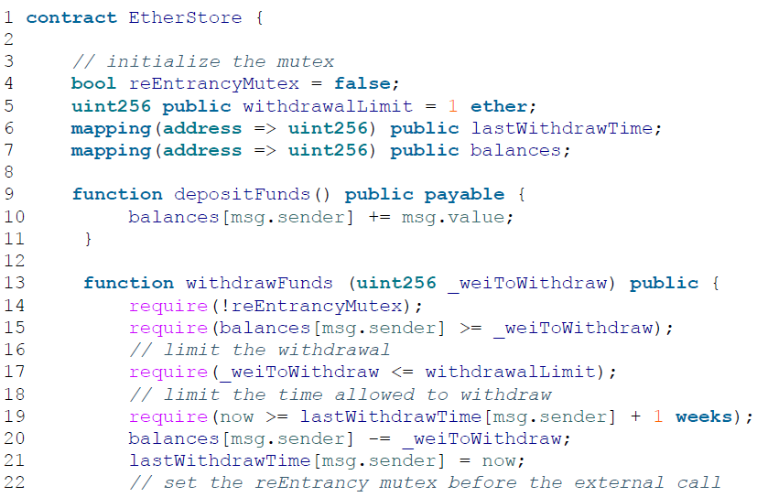
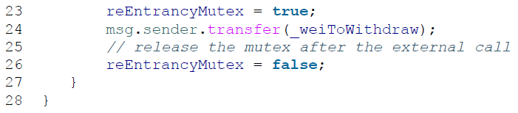
E.g. Reentrancy-Free Contract
Introduce a mutex state variable that locks the contract during code execution, preventing reentrant calls.
Ensure that all logic that changes state variables happens before ether is sent out of the contract (or any external call).
Use the built-in transfer function when sending ether to external contracts.

Slide 24
Security Risk: Arithmetic Over/Underflows
EVM specifies fixed-size data types for integers.
An integer variable can represent only a certain range of numbers. Variables in Solidity can be exploited if user input is unchecked and calculations are performed that result in numbers that lie outside the range of the data type.
E.g. Attacking a TimeLock contract (Example 9-3 in P.343).
Real-World Examples: PoWHC and Batch Transfer Overflow (CVE-2018–10299)
Preventative Techniques
Use or build mathematical libraries that replace the standard math operators addition, subtraction, and multiplication (division is excluded as it does not cause over/underflows and the EVM reverts on division by 0).
OpenZeppelin has done a great job of building and auditing secure libraries for the Ethereum community. Its SafeMath library can be used to avoid under/overflow vulnerabilities.

Slide 25

Security Risks…

Slide 26
Ref. Solidity Best Practices for Smart Contract Security
Use assert(), require(), revert() properly
Use modifiers only for checks
Beware rounding with integer division
Be aware of the tradeoffs between abstract contracts and interfaces
Fallback functions
Keep fallback functions simple
Check data length in fallback functions
Explicitly mark payable functions and state variables
Explicitly mark visibility in functions and state variables
Lock pragmas to specific compiler version
…

